Slide 1

Baggage Management System DMDD Project- Final Presentation
By,
Ruthvik Garlapati - 002727922
Mani Charan Reddy Loka - 002727403
Mudit Mathur - 001534196

Slide 2

Problem Statement
With the increase in travel, the last thing customers want is to lose their baggage at an airport. During the holiday season, customers often become the victims of baggage getting misplaced, which completely ruins their travel experience altogether.
The other possible way of losing baggage is when people with similar color and baggage type might take someone else’s, assuming it to be their own.

Slide 3
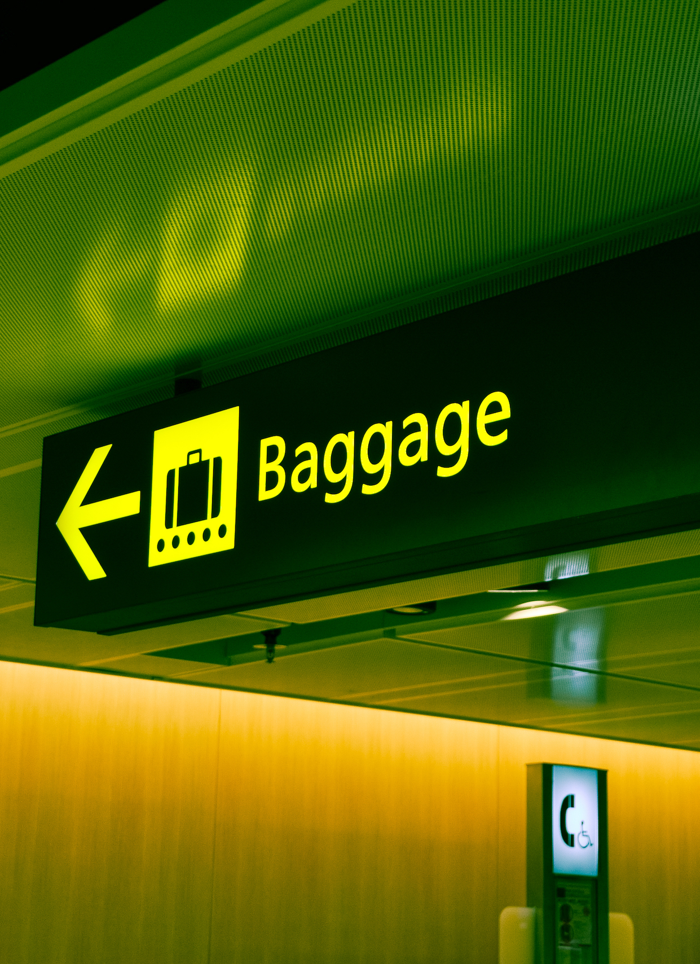
Objective
To develop a more comprehensive luggage management solution to help airport authorities better manage baggage transportation across airports and terminals and acts swiftly in case something goes wrong.
To find out where the baggage might have been lost and arrange to get it back to the customer in the minimum possible time.

Slide 4

Proposed Solution
By having a well-structured database that stores all the details to help identify the baggage and scan the baggage tag at every major step while verifying the same against the database prevents the baggage from getting misplaced.
And if at all the baggage gets misplaced by checking the last updated location, we can easily identify the exact location where it might have been lost and make arrangements for the baggage recovery without taking much time or issuing refunds.

Slide 5
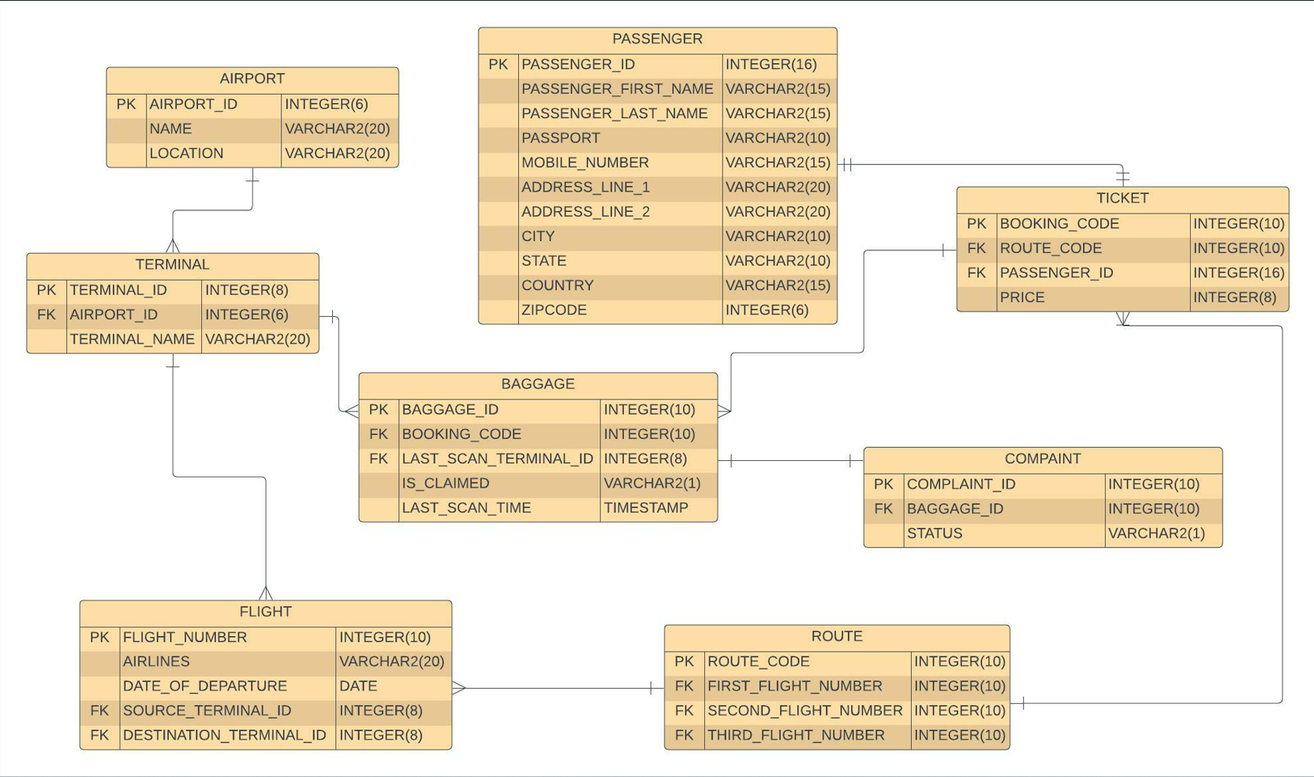
Entity-Relationship Diagram

Slide 6
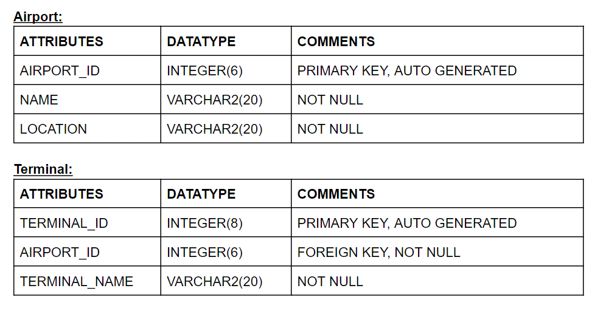
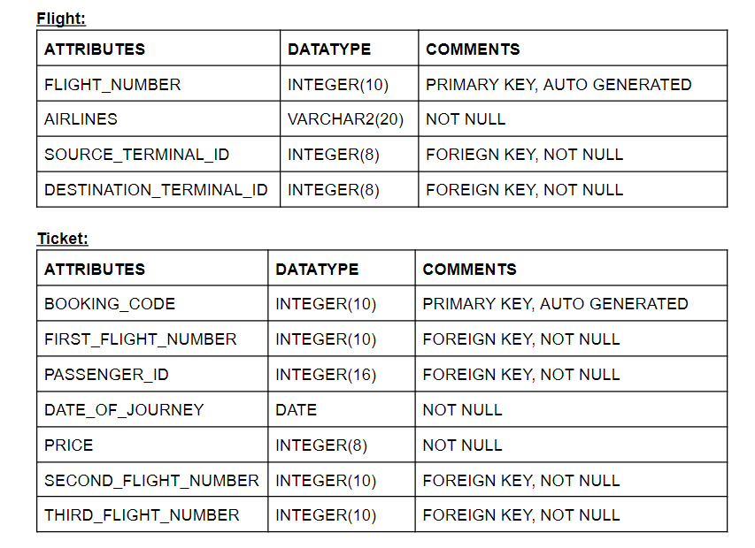
Entities and Attributes

Slide 7
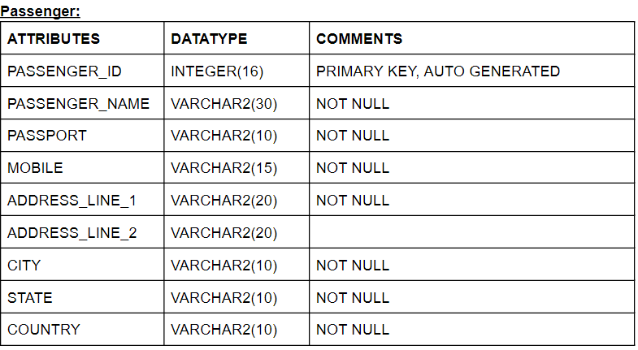
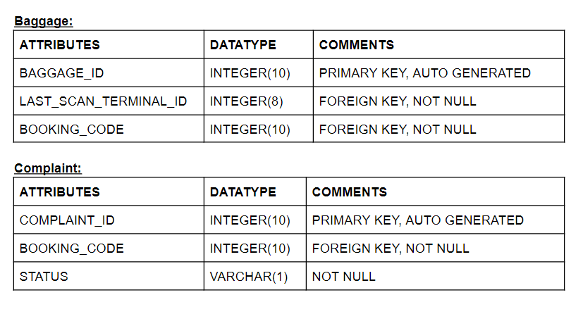
Entities and Attributes

Slide 8

Database Tables
Airport
Terminal
Flight
Route
Passenger
Ticket
Baggage
Baggage Data
Baggage Status
Complaint

Slide 9

Database Views and Reports.
Views for all the individual tables.
Claimed Baggage's.
Un-Claimed Baggage's.
Lost Baggage's.
Last Baggage's in the Last week.
Un-Claimed Baggage's in the last week.
Airport with highest number of lost baggage's.

Slide 10

Triggers.
Insert Terminals.
Insert Baggage's.
Update Ticket Price.
Update last scan terminal id in baggage.
Update last scan time in baggage.
Update baggage status upon reaching destination.

Slide 11
Procedures
Add Airport.
Update Route.
Add Flight.
Add Ticket.
Add Route.
Add Complaint.
Add Baggage.
Get Baggage History by Id.
Add Baggage Data.
Collect Baggage.

Slide 12
Roles.
Super Admin.
Application Admin.
Terminal Admin.
Resolution Manager.
Passenger.
Airlines Admin.
Analyst.

Slide 13
Security.
All the users in this application has access only to the API.
No User is allowed to Select, Update, Delete on tables directly.

Slide 14
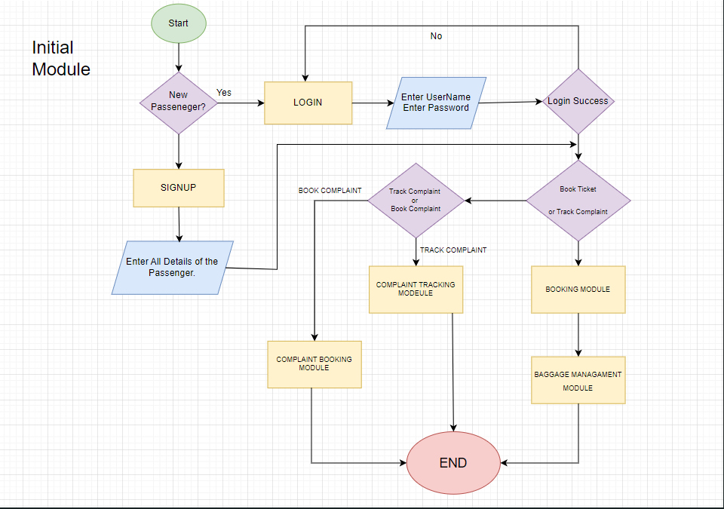
Initial Module.

Slide 15
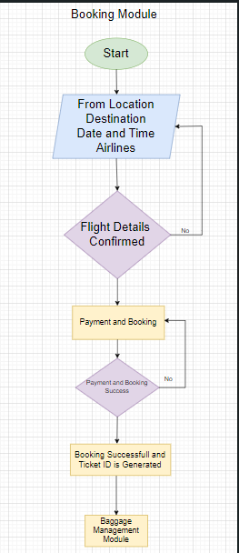
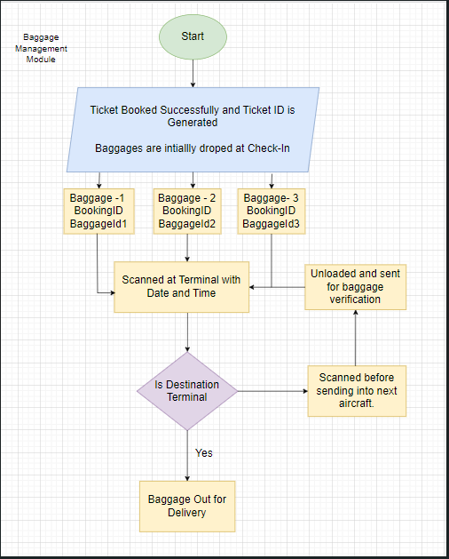
Booking Module Baggage Module

Slide 16

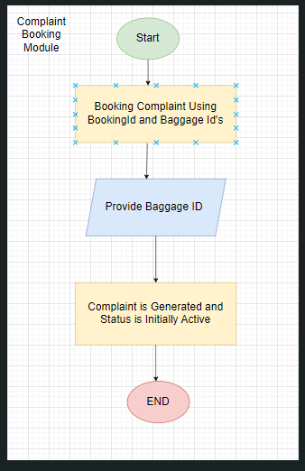



Complaint Module.

Slide 17

Let's See Demo......

